Slide 1


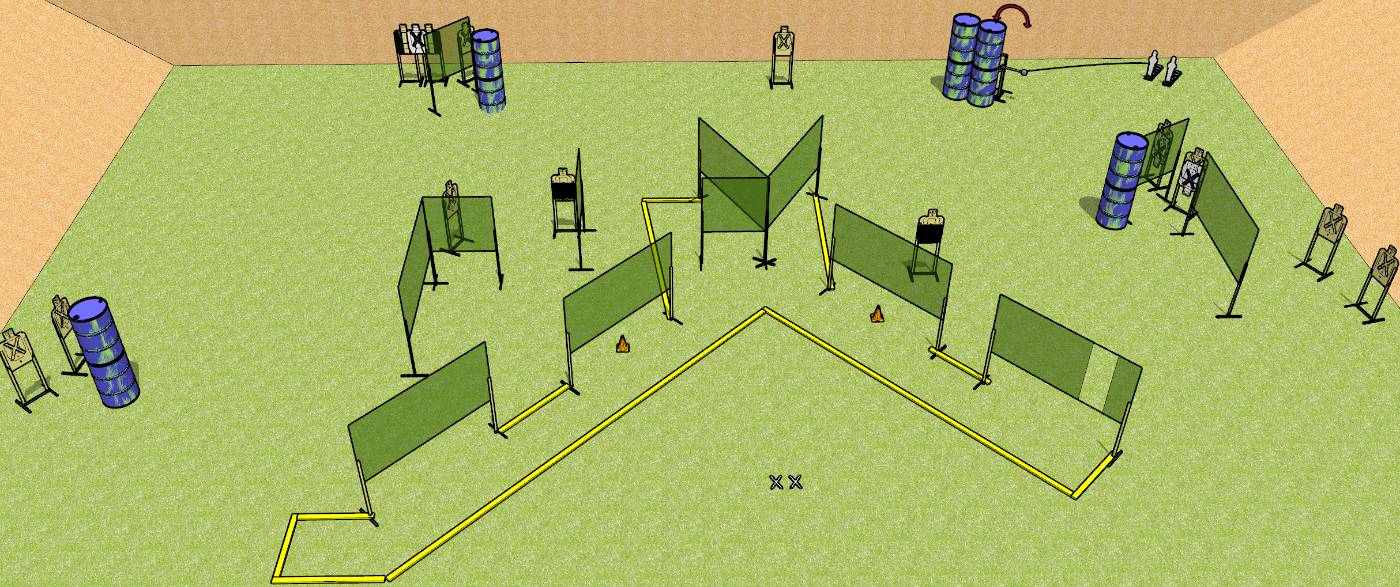
 | Dothan Gun Club – USPSA Match #SorryNotSorry Course Designer : Drew Coleman
START POSITION : Standing with both feet on X’s, wrists below belt
GUN READY CONDITION : Pistol loaded and holstered. PCC loaded, shouldered, safety on, pointed at either orange cone. |  | SCORING: Comstock, 30 rounds TARGETS: 14 paper, 2 Steel SCORED HITS: Best 2 on paper, steel until down START-STOP: Audible, last shot RULES:
STAGE PROCEDURE: Engage targets as they become available from within the fault lines.

Slide 2
#SorryNotSorry
Written Stage Briefing
#SorryNotSorry is a 30 round, 150 point, Comstock field course. There are fourteen USPSA targets and two mini poppers. The best two hits on paper will score and steel must fall to score. The start signal is audible.
Handgun start position is standing with both feet on X’s, wrists below belt. Handgun is loaded and holstered.
PCC start position is standing with both feet on X’s, muzzle aimed at either orange cone. Loaded carbine held with both hands, safety on, shouldered.
Upon start signal, engage targets as they become available from within the shooting area. The left mini popper activates the swinger.

Slide 3
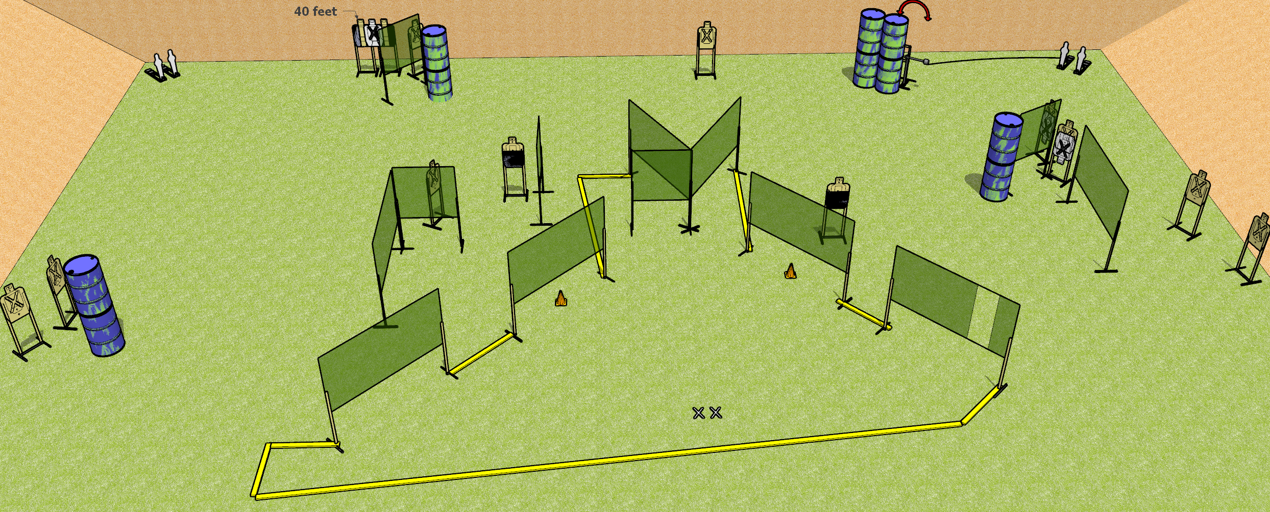
 | Dothan Gun Club – USPSA Match #SorryNotSorry Course Designer : Drew Coleman
START POSITION : Standing with both feet on X’s, wrists below belt
GUN READY CONDITION : Pistol loaded and holstered. PCC loaded, shouldered, safety on, pointed at either orange cone. |  | SCORING: Comstock, 32 rounds TARGETS: 14 paper, 4 Steel SCORED HITS: Best 2 on paper, steel until down START-STOP: Audible, last shot RULES:
STAGE PROCEDURE: Engage targets as they become available from within the fault lines.

Slide 4
#SorryNotSorry
Written Stage Briefing
#SorryNotSorry is a 32 round, 160 point, Comstock field course. There are fourteen USPSA targets and four mini poppers. The best two hits on paper will score and steel must fall to score. The start signal is audible.
Handgun start position is standing with both feet on X’s, wrists below belt. Handgun is loaded and holstered.
PCC start position is standing with both feet on X’s, muzzle aimed at either orange cone. Loaded carbine held with both hands, safety on, shouldered.
Upon start signal, engage targets as they become available from within the shooting area. The left mini popper activates the swinger.

